Slide 1


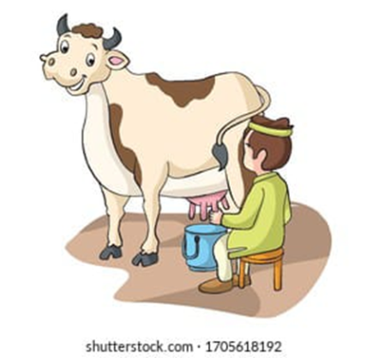
VISVESVARAYA TECHNOLOGICAL UNIVERSITY
GOVERNMENT ENGINEERING COLLEGE, RAMANAGARA
COMPUTER SCIENCE & ENGINEERING
PROJECT [21CSP76] – REVIEW 2
IOT-BASED MILK QUALITY ANALYZER
Team Members :
Chithrashree P [1GG21CS008]
Rakshitha S [1GG21CS040]
Sanjana [1GG21CS042]
Megha Ashok Naik [1GG22CS403]
Guided By :
Mrs. Harsharani K S
Coordinated By :
Dr. Shabeen Taj G A

Slide 2
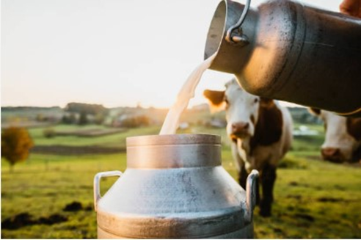
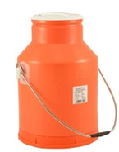
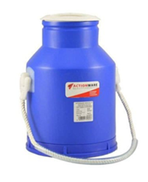
Agenda
1. Abstract
2. Introduction
3. Literature Review
Problem Identification
Existing System
Proposed System
8. Objectives
System Requirements
System Design
Conclusion
Future Scope
13. References
Notes:
S

Slide 3
ABSTRACT
In this project, we make an IoT model to check the quality of milk by embedding different sensors like bacterial activity monitored by a gas sensor, pH value monitored by pH sensor, ultrasonic sensors and temperature by the temperature sensor.
In small scale milk quality analysis is not developed only large scace it is developed, Ensure the system is cost-effective and accessible to small-scale farmers.
The results given by this model ensure the quality of milk by 90%. In the future, we will try to improve the percentage output of this model.

Slide 4

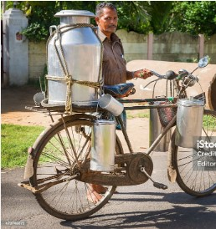
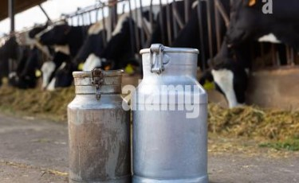
INTRODUCTION
An IoT-based Smart Milk Analyzer System helps monitor milk quality automatically. Sensors are placed in milk containers to measure things like temperature, freshness, and fat content.
This data is sent to a system where machine learning analyzes it to check for spoilage, contamination, or other quality issues.
This technology is useful for dairy farms and milk distributors to ensure milk stays fresh, reduce waste, and improve safety, all without needing constant human checks.

Slide 5
LITERATURE REVIEW
PUBLICATION | TITLE | AUTHOR | METHODOLOGY | LIMITATIONS
International Research Journal of Modernaztion In Engg. Tech & Science [2024] | Smart Milk Quality Analysis & Grading | S.B. Dighe, Utkarsha Kailas, Bonde Snehadip Girip, Verma Snehika | Integrates with cutting-edge sensor technology, gives solutions | Refining the system's accuracy
JETIR Organization [2023] | IoT-Based Detection of Adulteration in Milk | Kilari Jyothi, Vakacharla Vijaya Lalitha, Adari Hima Chandu, Pachakula Nookaraju , Satharu Malla Reddy | Finds the milk Adulteration using Arduino Uno controller and sensors. Blynk application for upload the data . | More complex to detect accuracy in real time
Department of Agroindustrial Technology IPB University [2022] | An analysis and design of fresh milk smart grading system based on IoT | W. Habsari, F. Udin, Y. Arkeman | ANN, K-means clustering, Selection of key features | Difficult to implement, issues with accuracy of data

Slide 6
LITERATURE REVIEW
PUBLICATION | TITLE | AUTHOR | METHODOLOGY | LIMITATIONS
Association for Agriculture Environment and Biotechnology [2021] | Arduino-Based Milk Quality Monitoring System | Sumithra Goswami, Ashok Dangi | Detecting Milk quality parameters using Arduino-Uno controllers and sensors | Lack of automated feedback
International Journal of Pure and Applied Mathematics [2018] | IoT Based Milk Monitoring System for Detection of Milk Adulteration | Dr.G.Rajkumar, Dr.T.Ananth Kumar, Dr. T.S.Arun Samuel, Dr. E.Muthu Kumaran | Arduino-Uno, LM35 temperature sensor, shows the different aspects of milk | Time-consuming for going and setting up the system

Slide 7
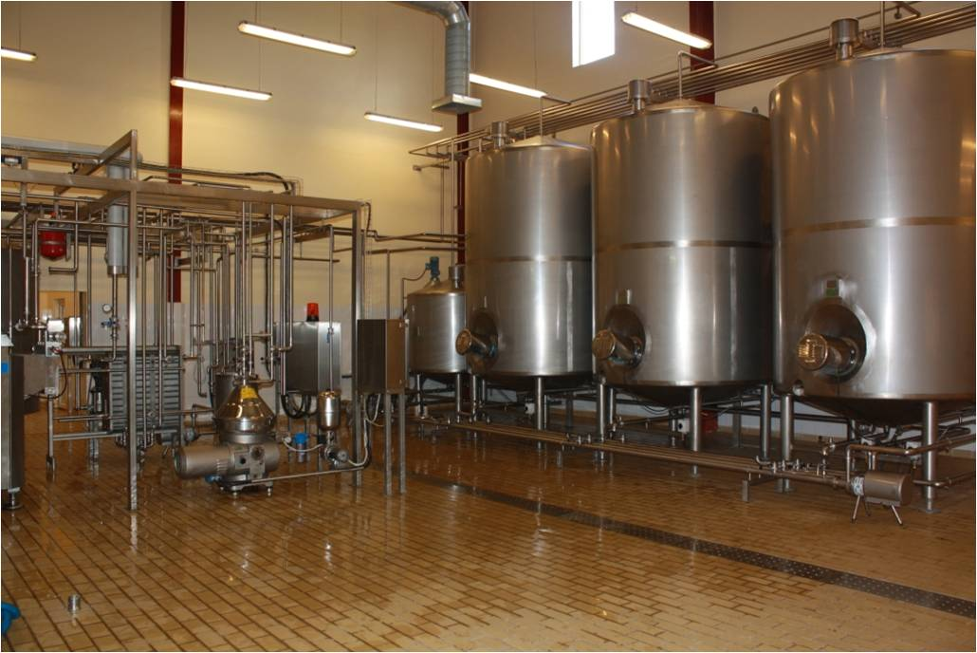

Problem Identification
In small scale milk quality analysis is not developed .
In large scale, already the setup is existed but it is costly and the components not available for every milkmen and Dairymen.
To overcome these problems we can use our model which is the solution for both problem, we can implement it for small scale with the minimal cost for analyze milk quality.

Slide 8
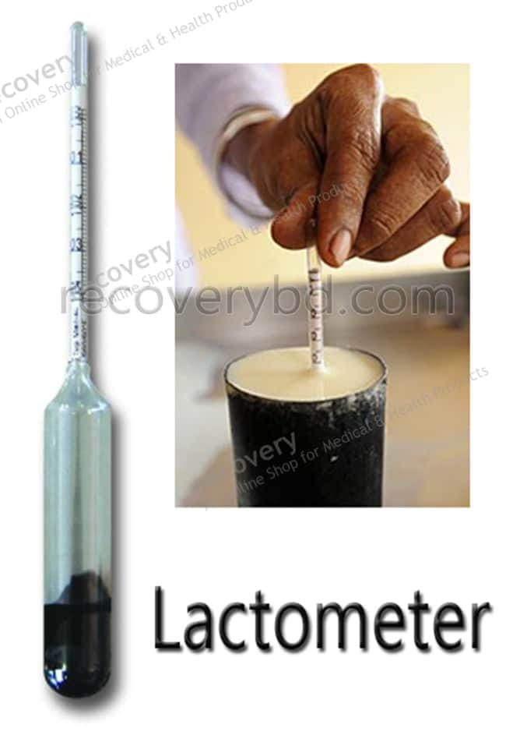
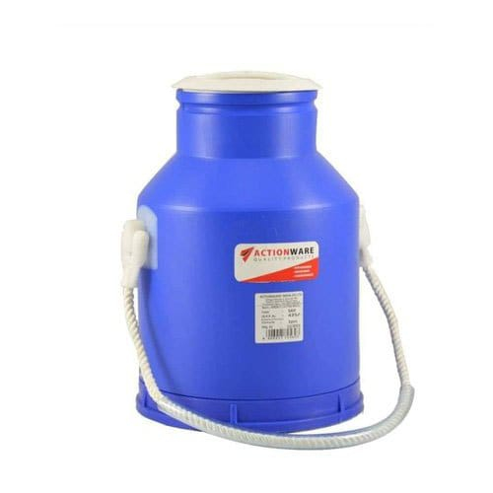
EXISTING SYSTEM
In the current system, Milk quality is traditionally tested using manual methods such as chemical testing and sensory evaluation.
These methods are time-consuming and prone to inconsistencies due to human error.
Automated systems exist but are expensive and require specialized equipment, limiting their accessibility.
Milk level monitoring in containers is rarely automated, leading to inefficiencies in stock management

Slide 9
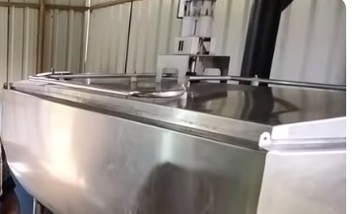
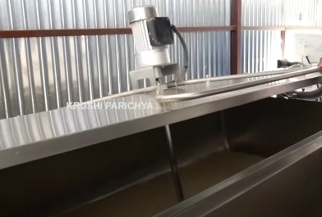
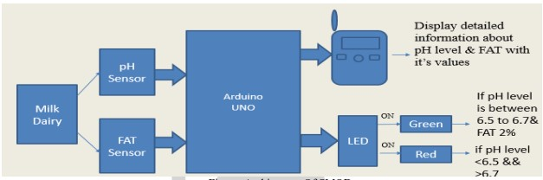
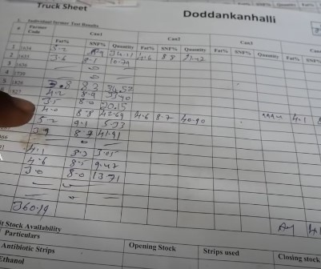
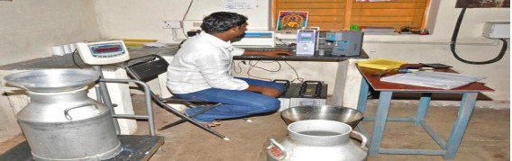
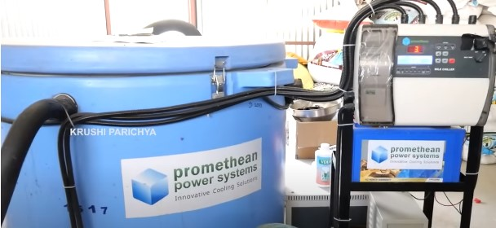
EXISTING SYSTEM

Slide 10
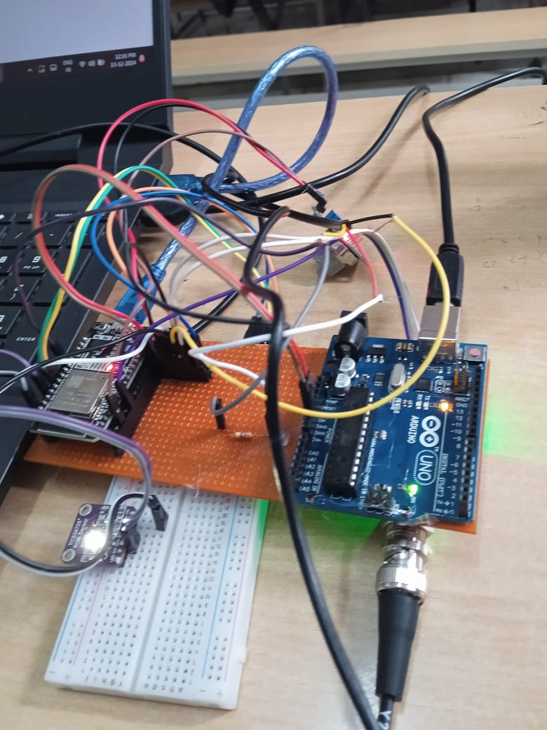
PROPOSED SYSTEM
The proposed system uses pH, temperature, and color sensors and ultrasonic sensors integrated with Node MCU to automatically classify milk quality.
Web application which gives the real-time data fetched by the milk quality analyzer.

Slide 11
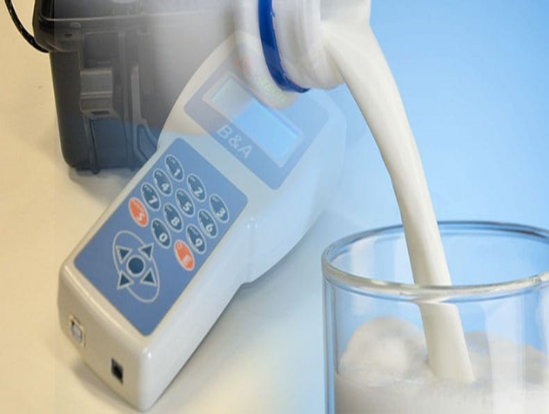
OBJECTIVES
Develop an IoT-based system for real-time milk quality monitoring.
Utilize sensors to measure key parameters like pH, gas concentration, and light absorption.
Implement an ultrasonic sensor for milk level detection in storage containers.
Ensure the system is cost-effective and accessible to small-scale farmers.
Promote transparency and accountability in the dairy supply chain.

Slide 12
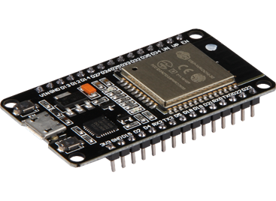
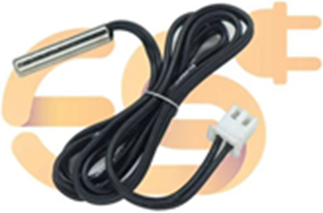
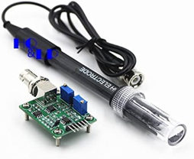
SYSTEM REQUIREMNTS
HARDWARE REQUIREMENTS
NodeMCU ESP32
ESP32 is a chip that provides Wi-Fi and (in some models) Bluetooth connectivity for embedded devices.
pH sensor(
A pH sensor helps to measure the acidity or alkalinity of the water with a value between 0-14.
pH value of the milk is between 6-7.
Temperature sensor(DS18B20)
A temperature sensor is an integrated circuit sensor that measures the centigrade temperature and provides an output voltage that is linearly proportional to the temperature

Slide 13
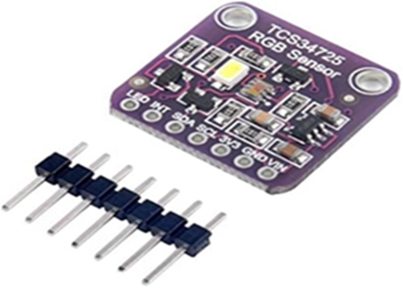
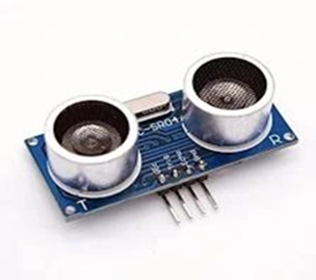
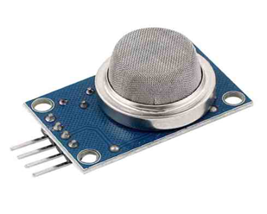
Color sensor(TCS34725)
Among sensors that detect light, those that detect the three primary colors of red, green, and blue are called color sensors.
Color sensors detect RGB values by receiving light.
Ultrasonic Sensor(HC-SR04)
Ultrasonic sensor is a kind of electronic device that uses ultrasonic sound waves to detect the distance between two objects.
Gas Sensor(MQ2)
Gas sensors are devices that help us understand the amount of gas in the environment and the natural state of its movement.

Slide 14

SOFTWARE REQUIREMENTS
Web Application
Html
CSS
JavaScript
Xampp
Arduino IDE
C++

Slide 15
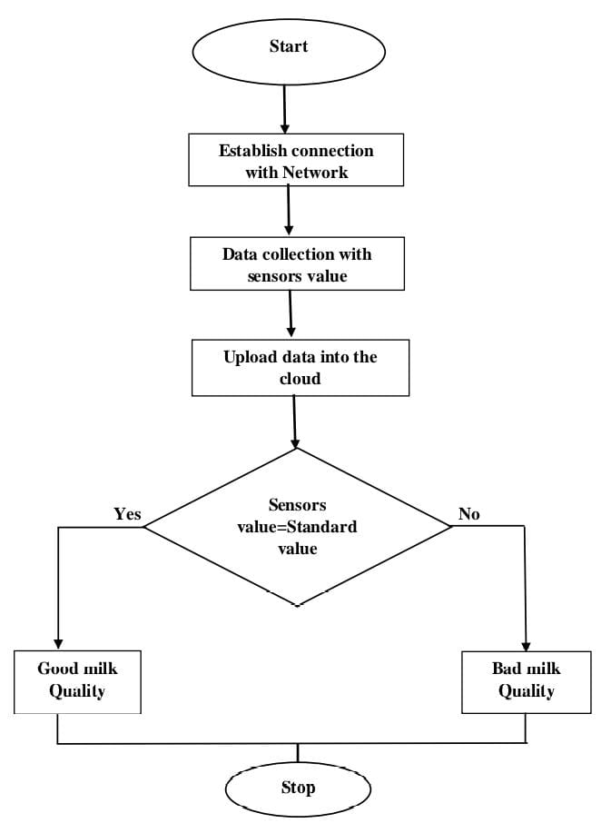
DESIGN FLOW DIAGRAM

Slide 16
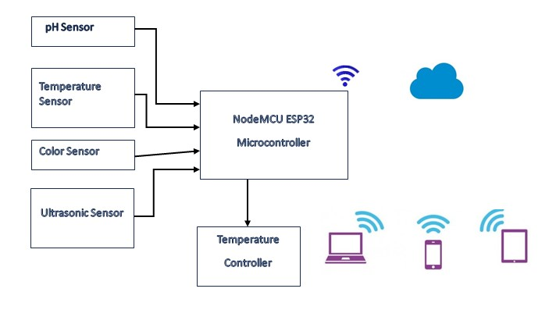

BLOCK DIAGRAM
CLOUD STORAGE

Slide 17
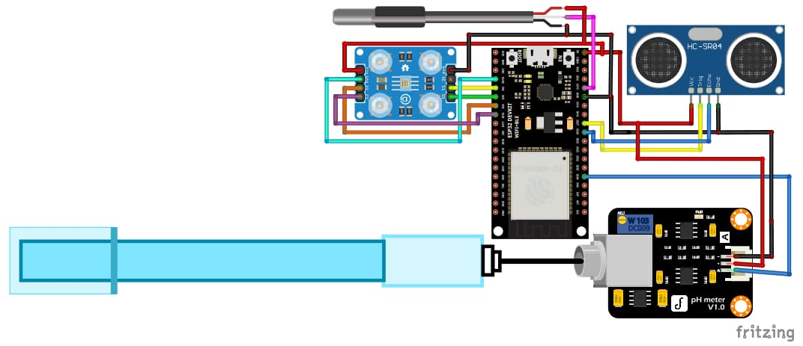
PIN DIAGRAM

Slide 18
UNIT TESTING
Test Case ID | Test Case Title | Expected Output | Result
1 | Working of pH sensor | Connection is successful and working | PASS
2 | Working of Temperature sensor | Connection is successful and working | PASS
3 | Working of Colour sensor | Connection is successful and working | PASS
4 | Working of Gas sensor | Connection is successful and working | PASS
5 | Working of Ultrasonic sensor | Connection is successful and working | PASS
6 | Working of ESP32 | ESP32 board is functional | PASS

Slide 19
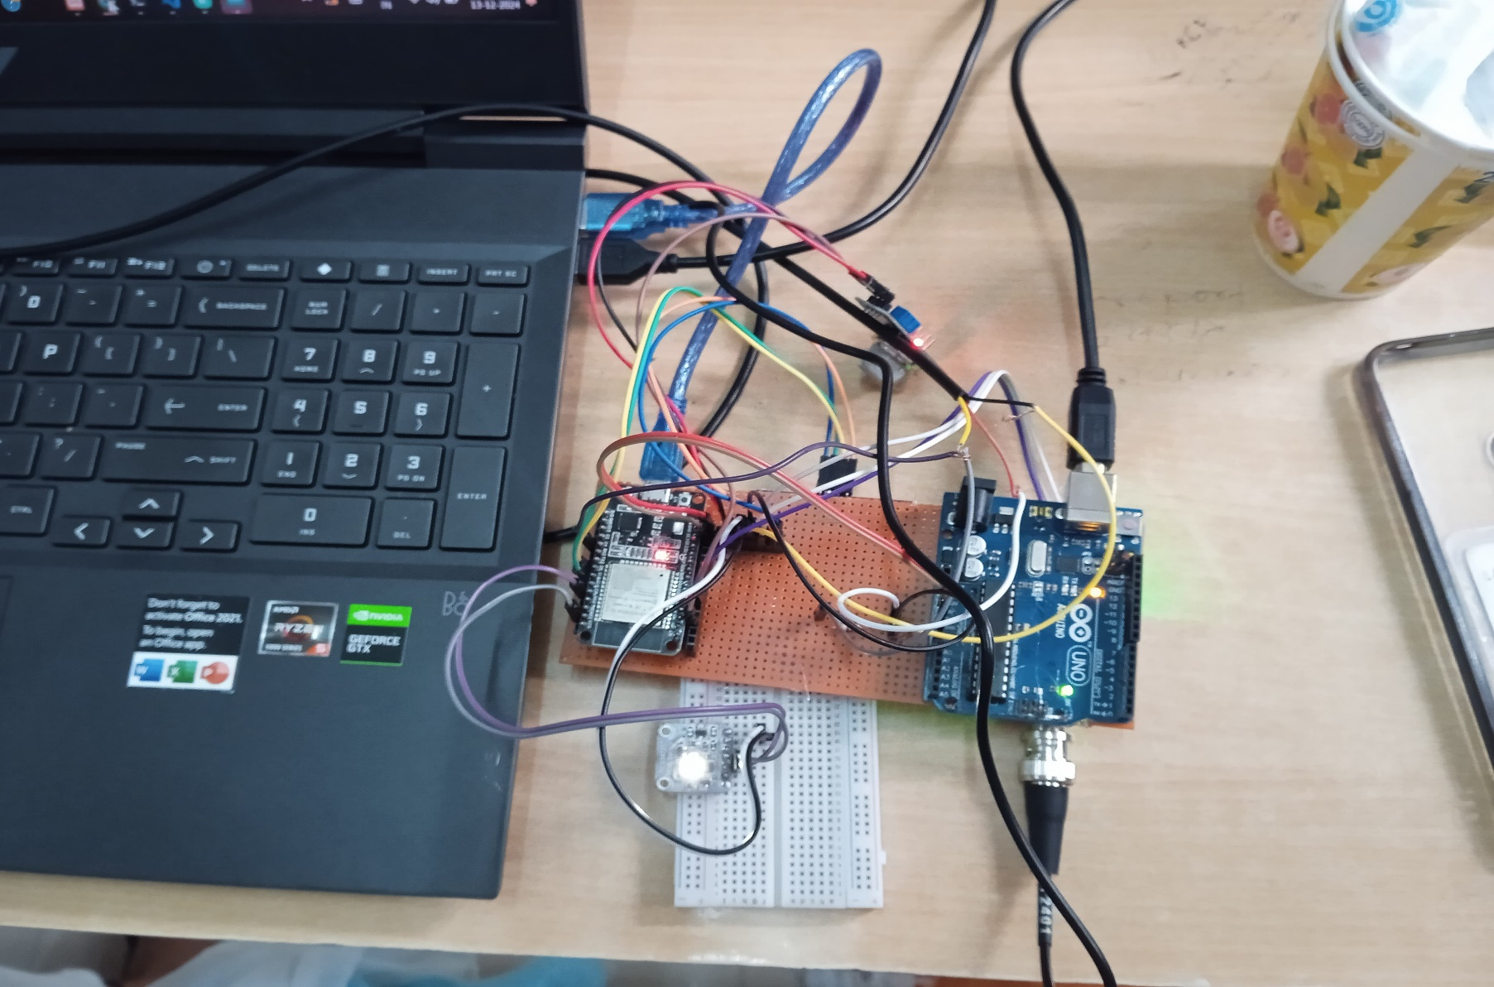
RESULTS

Slide 20
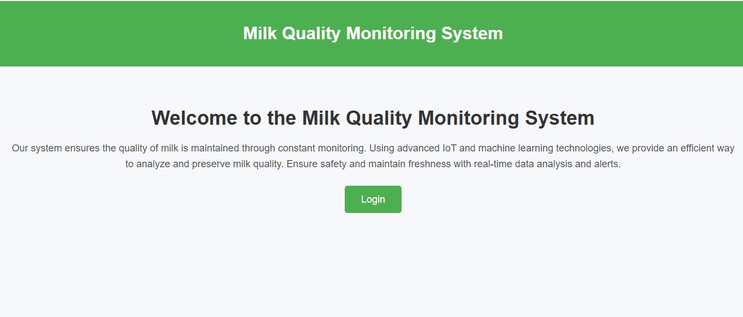


Slide 21
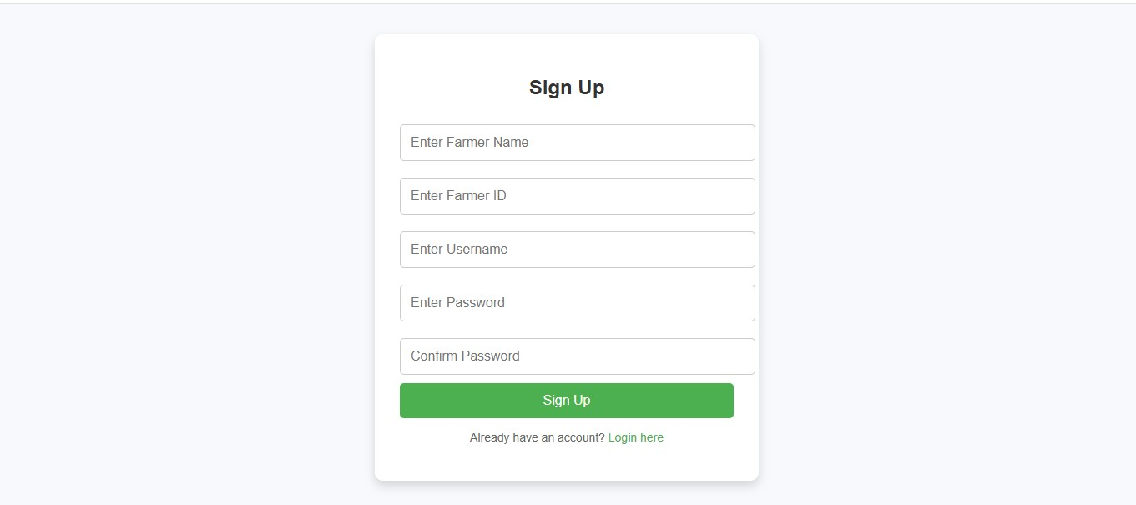
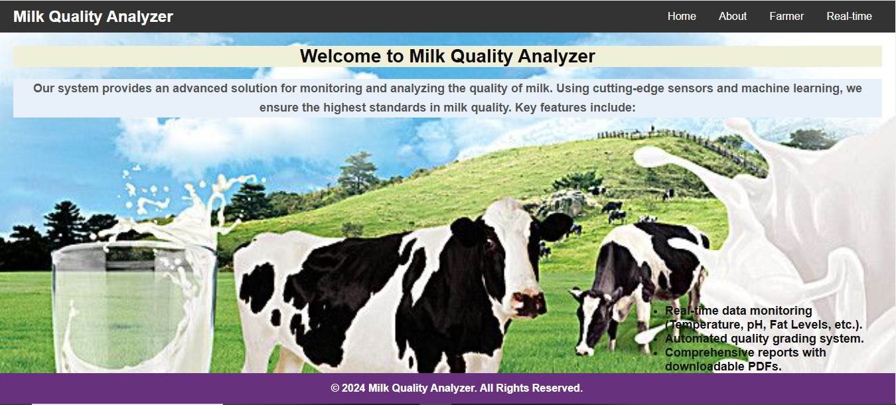

Slide 22
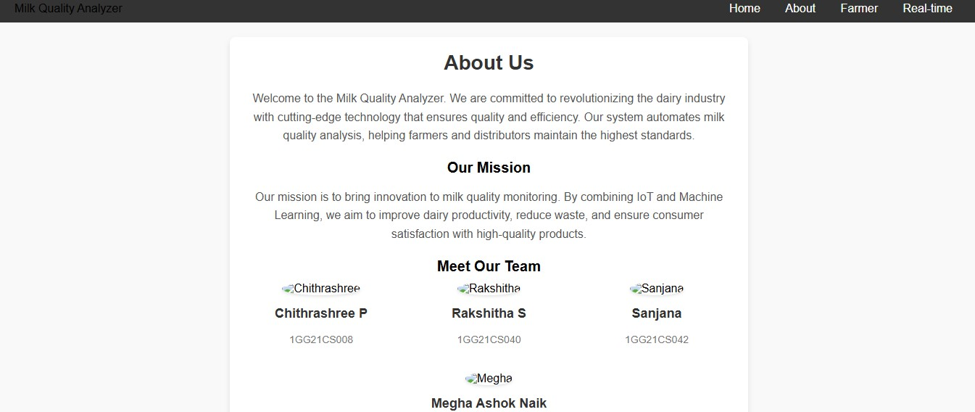
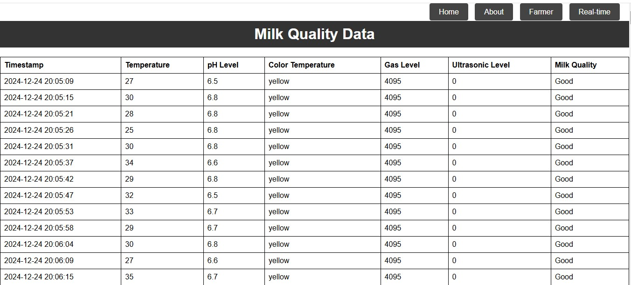

Slide 23
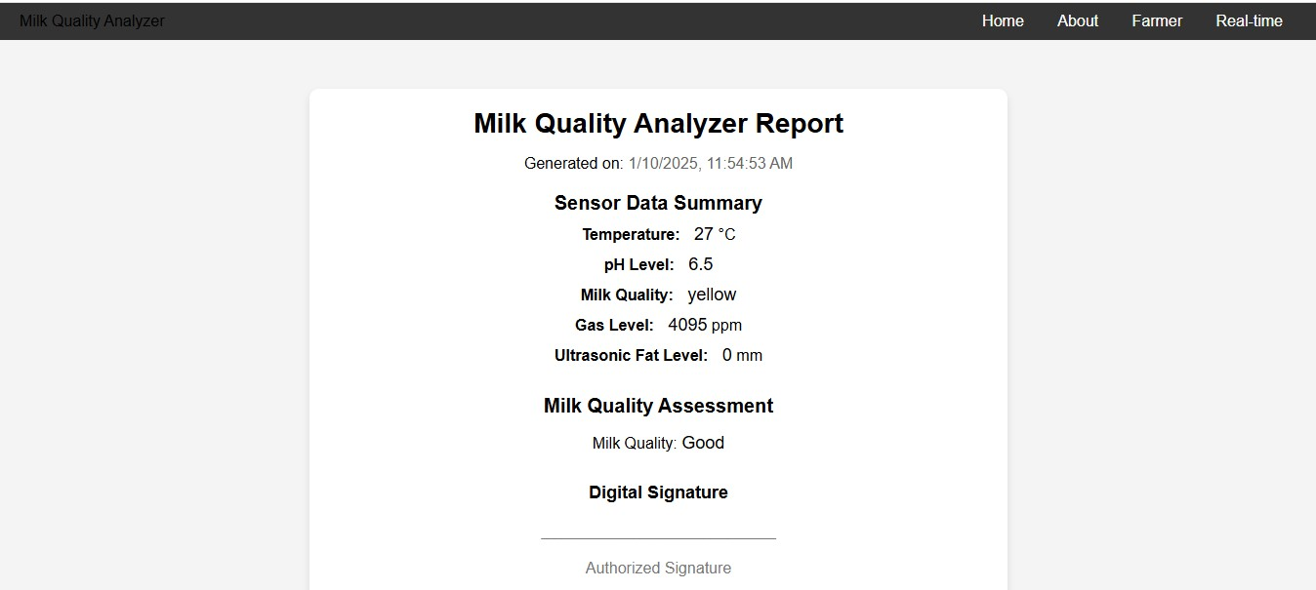

Slide 24
CONCLUSION
The integration of IoT for milk quality analysis demonstrates a significant step forward in ensuring safety and efficiency in dairy management.
The system effectively monitors crucial quality parameters, such as pH, gas levels, Temperature levels and light conditions.
This project provides an economically viable and scalable solution for dairy farms, processing plants, and retail industries.

Slide 25
FUTURE SCOPE
Enhanced Sensor Integration: Additional sensors for parameters like fat content, protein levels, and bacterial presence can provide a more comprehensive analysis.
Geolocation Features: Use GPS to track milk containers during transportation and ensure real-time quality monitoring.
Predictive Analytics: Develop predictive maintenance alerts for milk storage equipment using historical data trends.

Slide 26
REFERENCES
JETIR March 2023-IOT BASED DETECTION OF ADULTERATION IN MILK Kilari Jyothi,Vakacharla Vijaya Lalitha, Adari Hima Chandu, Pachakula Nookaraju ,Satharu Malla Reddy
International Research Journal of Modernization in Engineering Technology and Science(April-2024) SMART MILK QUALITY ANALYSIS & GRADING Prof. S. B. Dighe, Bad Utkarsha Kailas, Gorde Snehal Dilip,Varma Shrutika Sanjay
Milk Quality Prediction Using Machine Learning Drashti Bhavsar, Yash Jobanputra, Nirmal Keshari Swain, Debabrata Swain( 29 November 2023)
Department of Agroindustrial Technology IPB University[2022],An analysis and design of fresh milk smart grading system based on IoT. W. Habsari, F. Udin,Y. Arkeman
https://youtu.be/ua-m2gV9tME?si=y4WDsg6Vtxc55cQj
https://youtu.be/lCF6la-Wnks?si=58hsKHpM1JbMfjoD
https://youtu.be/bxmF6d-gbU8?si=xMgvGkGI47qt8I5a

Slide 27
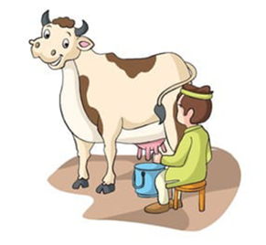
.
.
THANK YOU

